Slide 1
Planning for Integrated Care In General Practice (PIC GP) in LLR
Mark Pierce, Head of Population Health, NHS LLR ICB

Slide 2
Objectives
Describe background to case-finding approach
Describe criteria utilised to select patients
Describe methodology of allocating funding to participants
Describe structure of programme
Reflections

Slide 3
2016 – how would we choose patients for enhanced care programme?

Slide 4
The Need for Health Care Varies – All Secondary Care Costs
% of patients | No. of Patients | % of cost
These figures relate only to secondary care costs in Leicester City
They illustrate that just 0.5% of the population in Leicester City accounted for about 25% of secondary costs in the previous year
Another 46% of secondary care costs were attributable to the next 4.5% of the population
Overall about 20% of the population accounts for over 95% of all secondary care costs in a given year
At this time, no costs for pharmacy or primary care costs are available but will be in later iterations of the reports
0.5%
1.5%
3%
15%
80%
25%
26%
20%
25%
5%
2,082
62,453
333,080
6,245
12,491

Slide 5
Problems with focusing solely on the top 1-2%
Impactability? Is there really anymore that can be done? “We know these patients very well already!”
Regression to the mean?
Surely, it’s the over 65s we ought to be going for?

Slide 7
Frailty
Geriatricians tell us that about 70% of all in-patient bed days in UHL are used by people with a clinical frailty score of 6 or more

Slide 8
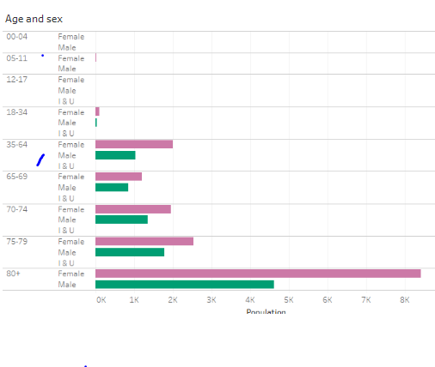
Frailty distribution LLR 2023

Slide 9
Multimorbidity Drives Cost – adults
Segments created by combining age of patient and the number of chronic conditions they have:
Number denotes number of chronic conditions:
0 = 0
1 = 1
2 = 2 to 4
5 = 5 to 7
8 = 8 or more
Letter denotes age band:
A = 0-17
B = 18-44
C = 45-64
D = 65-79
E = 80+
Multimorbidity more than age drives emergency admission costs
Multimorbidity does not just occur in the elderly
Notes:
[example chart used here is for ELR CCG]
Segments created by combining two measures:
The age of patients denoted by a letter, increasing with age (e.g. A=0-17yrs, B=18-44 yrs etc)
The number of chronic conditions grouped together (e.g. 0, 1, 2-4, 5-7, etc)

Slide 10
Multimorbidity Drives Cost
Increasing multimorbidity is associated with higher costs and resource use:
Notes:
Figures for WL CCG

Slide 11
Identified patient cohorts for STP 2015
Associated Annual Cost and Activity in Secondary Care

Slide 12
After discussion with clinical leads and the Board we settled on…
Five or more chronic conditions as flagged by ACG
Plus or minus – Frailty flag ON
Plus or minus Rescaled cost index of 3.0 or more
RUN THROUGH FINAL CLINICAL JUDGEMENT FILTER and open to clinician nomination regardless of criteria

Slide 13
Different stakeholders thought different things were more or less important…
The CCG was interested in care plans
GPs wanted more consultation time for complexity
The Meds Optimisation people wanted meds reviews
Public Health wanted social worker reviews
CCG Management said let’s allocate the funding as we always do –by weighted list size

Slide 14
We ended up with…(initially)
Enrolment fee
2 x 20 min (or 1 long forty min) pre-planned extra appointment(s)
Care plan from new or review existing care plan
Selected subset of all PIC patients referred to Care Navigators to lead MDT (we tried getting GPs to these – not successful)
Freedom to decide what the patient most needed – EoL discussion? MH review? Med Review? LTC support? Carer discussion?

Slide 15
How to allocate funding…
We ended up getting agreement to allocate funding based on the prevalence in your registered population of patients over 18 with the inclusion criteria. (Inner city Vs University is good example of need)
We had £630K and agreed £180 per patient.
Very accepted by practices
We had to create a “floor” so as to get everyone to sign up – each practice was guaranteed at least 15 patients
This was the beginning of understanding case-mix for us and led to bigger things…

